Slide 1
Streams, Rivers & Lakes

Slide 2
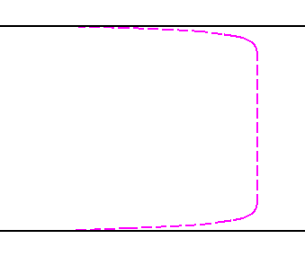
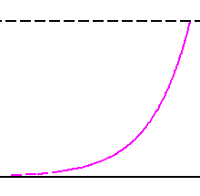
What Does Flow in a Stream/River Look Like?
Flow is Three Dimensional with important features in each direction: x (in direction of flow), y (transverse to flow) and z (vertical).
x,y (overhead view)
x,z (side view)
y
Free Surface
x
W
River Banks
H
River Bed
Turbulent – almost plug flow
At boundary is zero
Typically we treat as uniform
Log Profile increasing
toward free surface

Slide 3
What are we interested in Rivers
Think of situations where you might be interested in
(a) Transverse Mixing?
(b) Mixing over Depth?
(c) Longitudinal Transport?
As always, the answer to which you care about is problem specific, but most generally longitudinal transport is probably the most important – i.e. if you want to predict concentration of a contaminant downstream.

Slide 4
Based on What We Learned in Last Chapter
The full 3 dimensional Advection Dispersion Equation for this System is
Big and ugly; Hard to Solve, particularly if Dx, Dy and Dz depend on (x,y,z), which they can

Slide 5
DownsTream Transport
If I am only interested in downstream transport, surely I should only need a one-dimensional transport equation like:
Under what conditions can I do this? – i.e. look at the previous slide equation. What has to be true for the equation to collapse to the above one?
When vertical and Transverse Directions are Well Mixed dx
When does this happen?
Think back to last lecture (quiz)

Slide 6
Taylor Dispersion Video
random_walk.m

Slide 7
Well Mixed Transverse to Flow
You can assume that vertical gradients are negligible after
Likewise transverse gradients are negligible after
Therefore at least one of these times must have passed before you can treat the system as one dimensional

Slide 8
Under These Conditions
Treat a River as one-dimensional and use the full arsenal of weapons that you were given in the previous chapter:
How would you estimate u and D_{x} without actually going out and measuring them?

Slide 9
Log Law
x,z (side view)
Roughness Height
Free Surface
H
Von Karman constant
River Bed
Friction Velocity
S – Energy Gradient
Log Profile increasing
toward free surface

Slide 10
Dispersion
People like Fisher and GI Taylor produced an elegant formula for longitudinal dispersion. It is rigorous, but the derivation of it is cumbersome (if you’re interested take my advanced grad class).

Slide 11
SO
Once
Then

Slide 12
Transverse Dispersion Coefficients
By the way we never actually said what D_{y} and D_{z} are.
Again, they are typically related to stream/river characteristics. Typical formulations look like

Slide 13
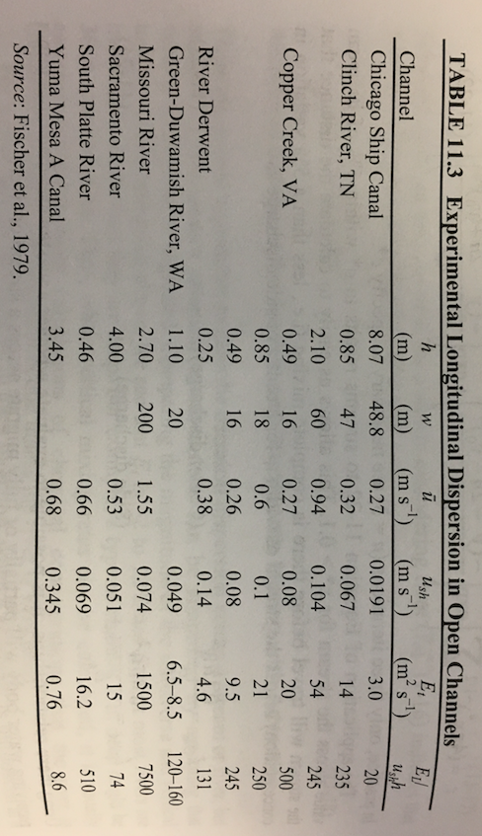
Typical Values

Slide 14
Also
I know the time when I can apply Taylor dispersion (i.e. assume transport is one-dimensional) – how far from a point spill must I be to be able to apply it?

Slide 15
Example Problem
A stream is 0.5 meters deep and 5 meters wide
The stream’s energy gradient is 1/1000.
The streambed is made up of gravel which results in a roughness height of about 5 cm.
What is the minimum time at which you could treat a contaminant spill as one-dimensional for this system?
What is the minimum critical distance at which you could treat a contaminant spill as one-dimensional for this system?
Imagine a point spill of 1kg occurred. Plot the expected breakthrough curve at a distance twice the critical distance downstream of the spill location.

Slide 16
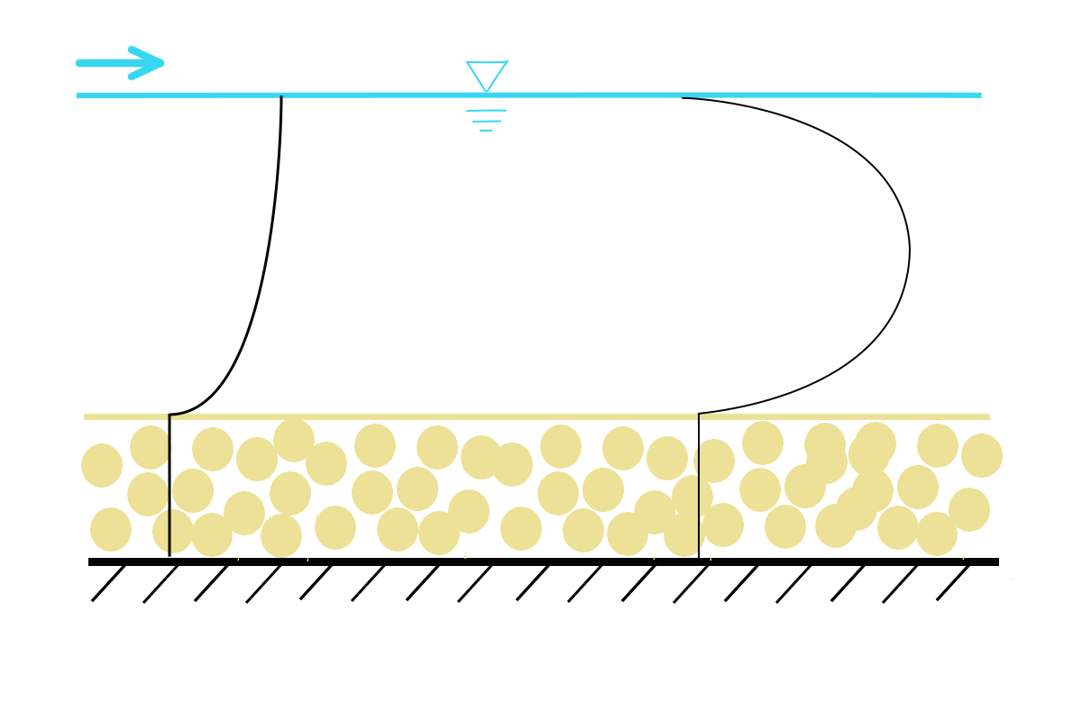
Reactions
Carbon photo-oxidation
Benthic Uptake
Denitrification
Let’s start with benthic…

Slide 17
First Order Approximation
While hopefully from the last figure you can see that chemical reactions do not happen evenly throughout the water column and we will get into the details of this a little bit, the most common first cut approximation is to treat the stream as well mixed (one-dimensional) and assume a first order effective reaction rate.
This is what is called an effective reaction rate.
It is not the reaction rate that you might measure
in the lab, because it lumps all of the complexity of the
system into a single number..
Typically lower than what you measure in the lab.

Slide 18
Consider This
What is solution to
How about
Take a guess at the solution to

Slide 19
That’s Right
The solution to
Is
In general if you know answer for conservative, multiply by decaying exponential like this!!

Slide 20
So what is
Remember, what is this without reactions – look at units!

Slide 21
So what is
The total amount of mass in your system is decaying exponentially over time

Slide 22
Consider This
You are in a river where the average downstream velocity is 1.2 m/s and the longitudinal dispersion coefficient is 0.1 m²/s.
You run an experiment with a conservative tracer and a reactive tracer and measure breakthrough curves at a distance 180m downstream of the injection point. You put in equal masses of each.
The peak concentration for the conservative tracer happens at 150 seconds. The concentration of the reactive tracer at the same time is 0.2 times that of the conservative tracer.
Estimate the effective reaction rate, which is primarily associated with an active benthic layer.

Slide 23
Steady State PRoblems
Consider steady state
And a continuous source at x=0
Solve this for me

Slide 24
If we include both advection and dispersion
Imagine you have a continuous source at x=0 and you are only interested in x greater than zero (semi-infinite domain)
The general solution to this ODE is

Slide 25
If we include both advection and dispersion
Imagine you have a continuous source at x=0 and you are only interested in x greater than zero (semi-infinite domain)
The general solution to this ODE is
A₁=0, because concentration must be finite as x->infinity

Slide 26
Example
A factory in west Ireland is dumping Chloromezalone into a stream at a concentration of 3 g/l. The stream has an average water velocity of 0.4 m/s and based on the bed roughness, height and width of the stream you estimate that the total longitudinal dispersion coefficient is 0.05 m²/s.
Chloromezalone is known to react in the benthos of the stream as bacteria love this stuff. You conduct a simple tracer test and infer for a stream like this that the effective reaction rate is γ=0.001 s⁻¹.
For centuries this stream has provided water to a small farm 500m downstream, which uses it to distill poitin, delivered outside mass every Sunday. The O’Brians have never failed to deliver and Fr Podge has often believed war would break out should they fail (hence he allows the practice).
Unfortunately concentrations of Chloromezalone higher than 0.5 g/l are known to inhibit certain reactions essential to the creation of this fine and peace keeping beverage….. Should Father Podge be concerned for peace in his parish.

Slide 27
Let’s look at Photo Reactions
Carbon photo-oxidation
Benthic Uptake
Denitrification

Slide 28
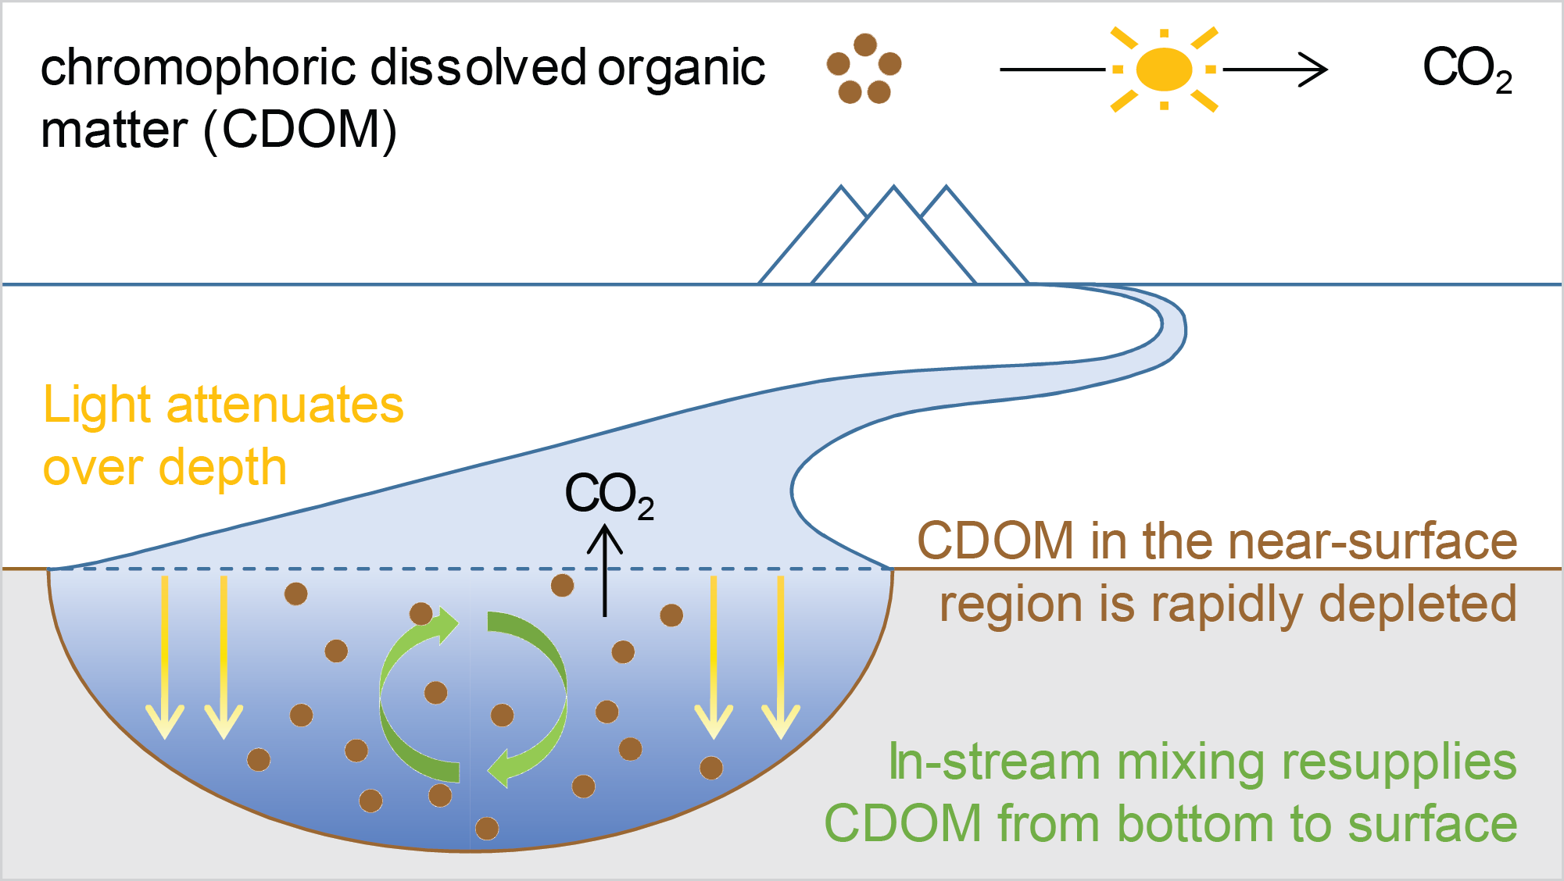
Example

Slide 29
1-dimensional Vertical Model (Lake or River)
Let’s assume that downstream gradients in the thing we are interested in are negligible (what does this mean and can you think of an example?). Or that a lake is horizontally well mixed.
Light
This is our conceptual model:
Transport is by vertical dispersion…
Reaction is proportional to light intensity...
Assume steady state.....
H
Constant Concentration Bottom Boundary

Slide 30
Mathematical Model
Based on our conceptual figure and ideas
Light
Transport is by vertical dispersion…
H
Constant Concentration Bottom Boundary

Slide 31
What about reaction
Assume zeroth order (often assume first order, but maths gets complicated and I want to focus on general idea first – we will look at complicated maths next):
i.e. does not depend on C – what does this mean?
Light attenuation means light intensity decays exponentially with depth in water
How about:

Slide 32
Therefore
Our governing equation is
Taking D as constant
What is this equation saying?
Put it in words…
Solve this equation for me now..

Slide 33
Solution
Integrate Once
Integrate Again

Slide 34
Therefore
Do you see a problem with this solution?
Zeroth order approximation only good in certain circumstances – what are they?

Slide 35
What about First Order reaction
Assume first order:
Light attenuation means light intensity decays exponentially with depth in water
How about:

Slide 36
Therefore
Our governing equation is
Taking D as constant
What do we do now?
This is pretty hard to actually solve

Slide 37
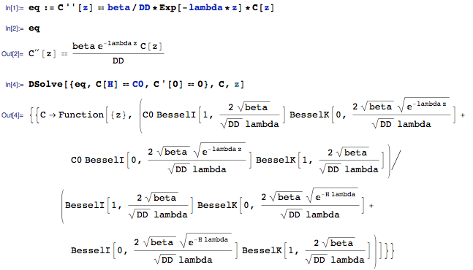
This is where Mathematica is a Saviour

Slide 38
Sample Problem
You are in an arctic stream and want to estimate how mush CO2 is being belched out a day per meter of stream. The vertical dispersion coefficient is 0.1 m²/s. The concentration of DOC at the bottom of the stream of depth 10cm is 1g/m. Light attenuates with depth a rate of 20m⁻¹.
Consider a zeroth order reaction with
And a first order reaction with
Calculate and compare the total amount of CO2 being produced
Under these two different reactions.
You may assume known concentration at the bottom of the stream
And no flux of DOC at the stream surface.

Slide 39
Mixing in Lakes.
Lakes are complicated beasts and we won’t enter into all details as behaviors are different based on size, shape of lake, number of inputs and outputs etc. In the next chapter we will look at nutrient loading and how this can give rise to algal blooms etc., but in the context of this chapter we will treat lakes in one of two ways
(i) Well mixed control volumes with mass balance
Or
(ii) one-dimensional columns that mix things vertically

Slide 40
Compartmental Models
Lakes are often modeled as different sections, each of which are well mixed, e.g.
Evap
Precip
Sw_{in,1}
Sw_{out,1}
Layer 1
RXN₁
Exchange₁₂
Gw_{in,1}
Gw_{out,2}
Gw_{in,2}
Gw_{out,2}
Layer 2
RXN₂
Gw_{in,3}
Layer 3
Exchange₂₃
Gw_{out,3}
RXN₃
We can as many layers as we want
Write a Mass Balance Equation For Each Layer!

Slide 41
Mass Balance – No RXNs
Layer 1
Layer 2
Layer 3

Slide 42
How can we simplify?
Assume Well Mixed- any concentration leaving a layer is the concentration of that layer.
Assume the volume of each layer is fixed
Assume exchange between layers is perfectly balanced (e.g. Q_{1,2}=Q_{2,1}) – can you justify this? What does it mean?
Precipitation and Evaporation Balance; Groundwater Input and Outputs Balance; Surface Water Inputs and Outputs Balance - Is this reasonable?
Precipitation and Evaporation carry negligible loads (when might this be a bad assumption – think of an example??)
All GW is equally loaded with whatever substance you’re interested in

Slide 43
Mass Balance – No RXNs
Layer 1
Layer 2
Layer 3

Slide 44
Now What??
RECALL CHAPTER 1
STEADY STATE
EXPONENTIAL LIKE SOLUTIONS
MATHEMATICA
MATLAB

Slide 45
Example
A lake of 1000 m³ can be broken into a surface layer of 500 m³ and two deeper layers of equal size. The top layer is fed by a contaminated stream with concentration 5g/liter, which flows in at a rate of 20 m³/hr. It is drained by a similar stream. Groundwater flow in the surface layer is negligible compared to the surface water input. Both deeper layers are fed by groundwater at rates of 2 m³/hr. The groundwater in this area is pristine. The surface and middle layer have a turbulent exchange rate of 5 m³/hr, while the middle and lower layer have an exchange rate of 1 m³/hr.
Write down evolution equations for the concentration in each layer.
Given enough time, what will the concentration profile in the lake look like?
Assume the lake starts out perfectly clean and plot how the concentrations evolve over time. Is your result consistent with your answer above?

